Slide 1














MUSIC STORE:
REVENUE INTELLIGENCE
-BY AMRITA SAMUEL

Slide 2

INTRODUCTION:
The Music Store Revenue Intelligence project leverages SQL queries to analyze key revenue drivers, customer spending patterns, and market trends in a digital music store. It utilizes various SQL concepts, including aggregation functions (SUM, COUNT, AVG) for revenue calculations, JOIN operations (including INNER JOIN and LEFT JOIN) to combine customer, invoice, and track data, subqueries and Common Table Expressions (CTEs) for filtering top artists and customer spending, window functions (ROW_NUMBER()) for ranking top customers and genres by country, and sorting (ORDER BY) and grouping (GROUP BY) for structured analysis. The project offers data-driven insights to optimize sales, marketing, and artist collaborations.

Slide 3
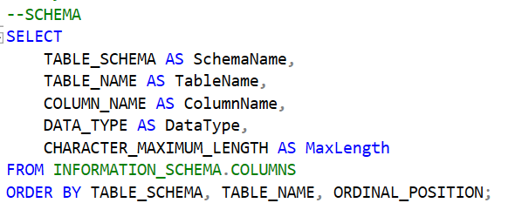
SCHEMA

Slide 4


PART1-EASY Q’S:
Q1)WHO IS THE SENIOR MOST EMPLOYEE
BASED ON JOB TITLE?

Slide 5
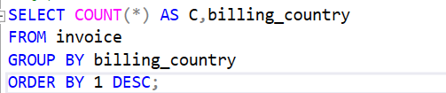
Q2)WHICH COUNTRIES HAVE THE MOST INVOICES?

Slide 6


Q3)WHAT ARE THE TOP 3 VALUES OF TOP INVOICE?

Slide 7

Q4: WHICH CITY HAS THE BEST CUSTOMERS? WE WOULD LIKE TO THROW A PROMOTIONAL MUSIC FESTIVAL IN THE CITY WE MADE THE MOST MONEY.
Write a query that returns one city that has the highest sum of invoice totals.
Return both the city name & sum of all invoice totals.

Slide 8
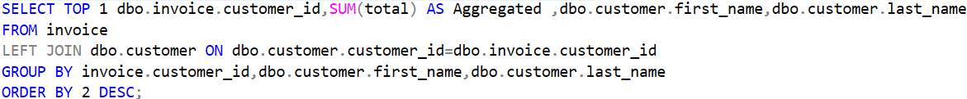
Q5: WHO IS THE BEST CUSTOMER? THE CUSTOMER WHO HAS SPENT THE MOST MONEY WILL BE DECLARED THE BEST CUSTOMER. Write a query that returns the person who has spent the most money.

Slide 9
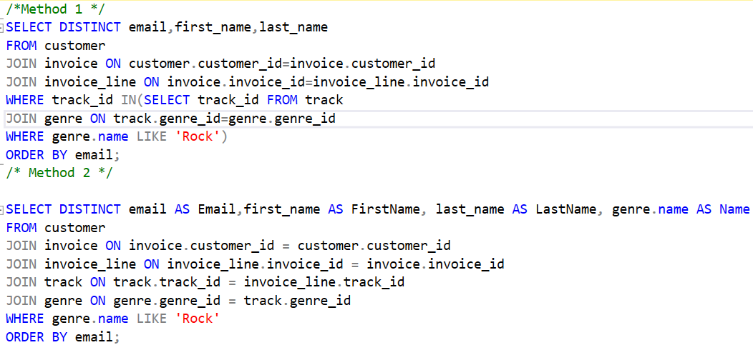
PART2-MODERATE Q’S:
Q1) WRITE QUERY TO RETURN THE EMAIL, FIRST NAME, LAST NAME, & GENRE OF ALL ROCK MUSIC LISTENERS.
RETURN YOUR LIST ORDERED ALPHABETICALLY BY EMAIL STARTING WITH A.

Slide 10
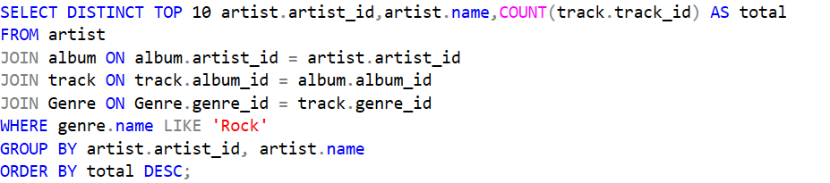
Q2: LET'S INVITE THE ARTISTS WHO HAVE WRITTEN THE MOST ROCK MUSIC IN OUR DATASET.
Write a query that returns the Artist name and total track count of the top 10 rock bands.

Slide 11
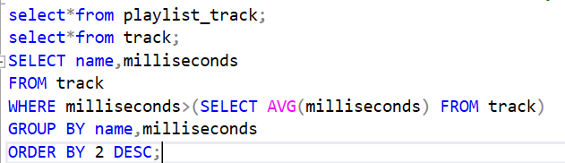
Q3: RETURN ALL THE TRACK NAMES THAT HAVE A SONG LENGTH LONGER THAN THE AVERAGE SONG LENGTH.
Return the Name and Milliseconds for each track. Order by the song length with the longest songs listed first.

Slide 12
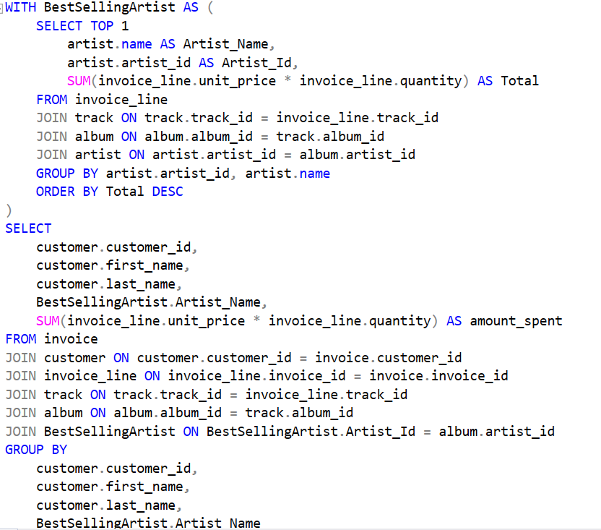
PART3-ADVANCED Q’S:
Q1) Q1: FIND HOW MUCH AMOUNT SPENT BY EACH CUSTOMER ON ARTISTS? WRITE A QUERY TO RETURN CUSTOMER NAME, ARTIST NAME AND TOTAL SPENT

Slide 13
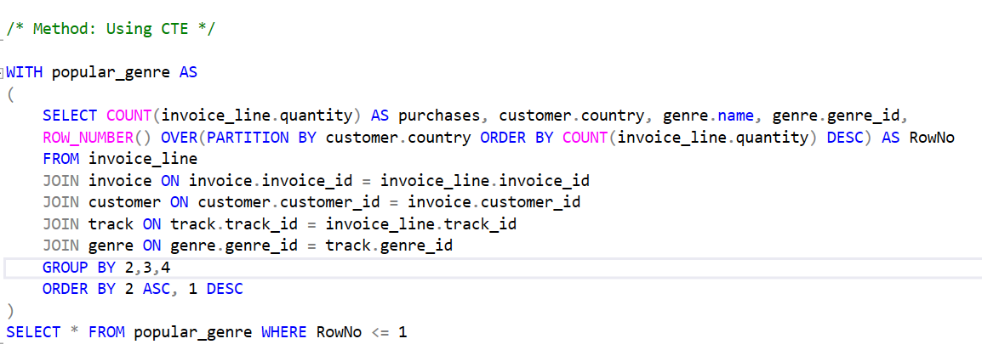
Q2:WE WANT TO FIND OUT THE MOST POPULAR MUSIC GENRE FOR EACH COUNTRY. WE DETERMINE THE MOST POPULAR GENRE AS THE GENRE
WITH THE HIGHEST AMOUNT OF PURCHASES. WRITE A QUERY THAT RETURNS EACH COUNTRY ALONG WITH THE TOP GENRE. FOR COUNTRIES WHERE
THE MAXIMUM NUMBER OF PURCHASES IS SHARED RETURN ALL GENRES.

Slide 14
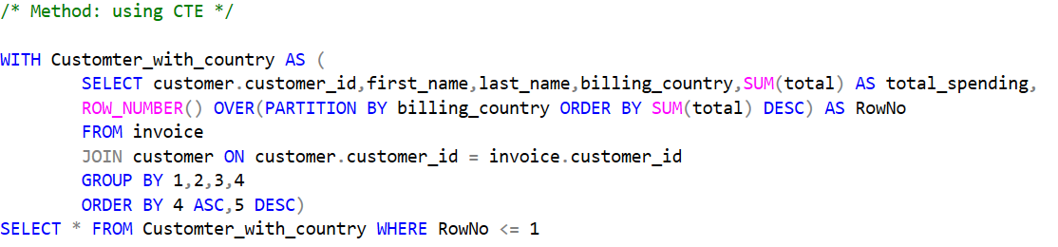
Q3: WRITE A QUERY THAT DETERMINES THE CUSTOMER THAT HAS SPENT THE MOST ON MUSIC FOR EACH COUNTRY.
Write a query that returns the country along with the top customer and how much they spent.
For countries where the top amount spent is shared, provide all customers who spent this amount.

Slide 15
THANK YOU VERY MUCH!

